Slide 1
Digital Logic Analyzer
CPE 509 Project

Slide 2
Group 8 Members
Taiwo Oluwatomisin O. CSC/2014/081
Talabi Oluwasegun O. CSC/2014/082
Yeko Joseph O. CSC/2014/085
Yusuff Airat O. CSC/2014/086
Abon Adepeju T. CSC/2015/109

Slide 3
Digital Logic Analyzer Overview
An electronic instrument that captures and displays multiple signals from a digital system or digital circuit.
Logic analyzers have advanced triggering capabilities which are useful when a user needs to see the timing relationships between many signals in a digital system.
Used to investigate and understand digital and logic circuits.
Can also be used to note faults in them if the circuits do not operate as expected based on manual computation.

Slide 4
Technologies and Tools Used
2 x Altera DE2 boards for programming and implementation;
VHDL codes for the development of an Annular pulse generator and the setup of the logic analyzer;
Female-female jumper wires for feeding output from the pulse generator and input to the board configured to work as the logic analyzer;

Slide 5
Methodology
Annular pulses were developed on an Altera DE2 board since they provide continuous clock outputs beneficial to the intended logic analyzer.
One of the benefits of a logic analyzer is that it allows the reading and analysis of several signals simultaneously and to fully display its capabilities, an annular pulse generator deemed fit.
The output from the pulse generator were sent out through the expansion header of the board and received through the expansion header on the logic analyzer board;
Using the signals received as input, selecting the inbuilt 50MHz clock input and trigger conditions, the pulses from the output of the Annular pulse generator can be analyzed synchronously.

Slide 6
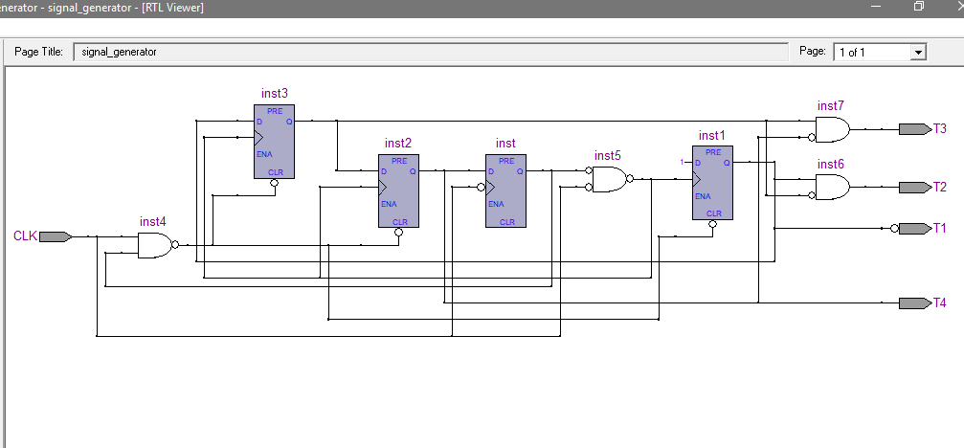
Annular Pulse Generator

Slide 7
Logic Analyzer Operation
The analyzer is on ‘timing’ mode because it utilizes its internal clock input and not clock from the device under test.
One of the continuous pulse outputs from the generator sent in as input to the analyzer is used as a trigger.
Low and high states from the inputs initializes the analysis and the results are displayed in a waveform.

Slide 8
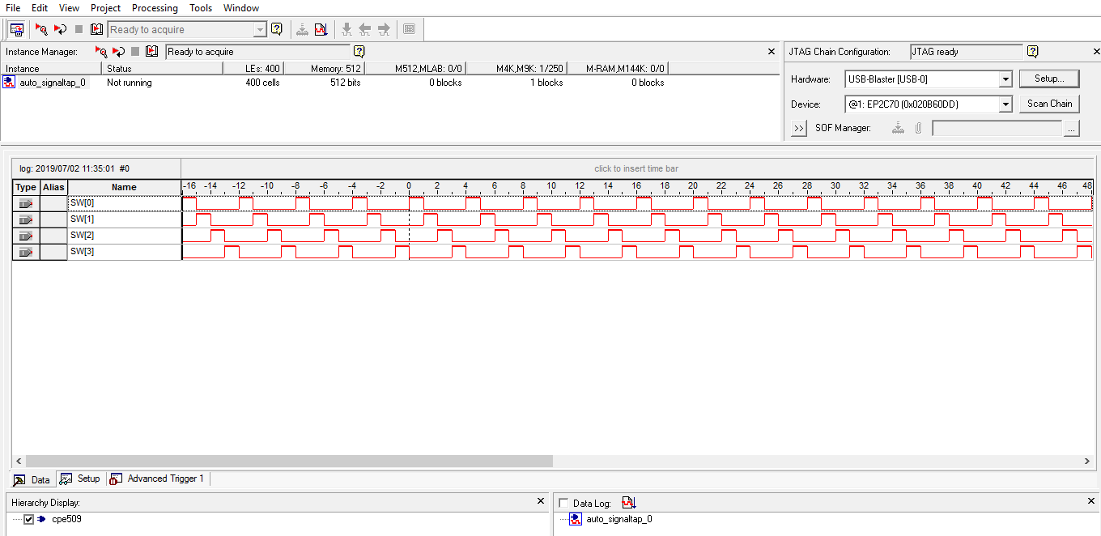
Analyzer results

Slide 9
…determine whether the VHDL code of both the pulse generator and the logic analyzer is consistent with the function for which it was written, whether they can be loaded on the FPGA board, whether after being loaded on the board, the desired outputs are generated.
Testing and Evaluation

Slide 10
Testing
Severally checked for errors and corrected where necessary;
Verification process involved checking that the program conforms to its specification;
Validation involves checking that the program as implemented meets the expectations of the user;

Slide 11
Evaluation
A decision was taken early on in the project to use the Quartus II project software, since the project required the use of a FPGA.
Apart from it being an accepted format, it lends itself to the integration of both design and implementation.
Evaluation, being of significant mention in a development process has been incorporated into this project at various stages during development.

